Slide 1

Character Recognition in Natural Images
Kevin Crosby
Divergence Academy
Data Science Immersive - WE 2021-04
September 19, 2021

Slide 2
Introduction
Engineering and Mathematics degrees
Studied Artificial Intelligence in Grad school
Worked at Johnson Space Center
Changed careers to Natural Language Processing in 2014
Experience expanded to include Data Engineering, Machine Learning, and Data Science
Enrolled in Divergence Academy to fill in gaps in knowledge and put career on more solid footing

Slide 3
Problem or Analysis
How can we use Computer Vision (CV) to understand characters on signs?
First step in determining words on signs
Then can determine business names, street names, etc.
Eventually …
sign translation
enhance self-driving vehicle navigation
text-to-speech for visually impaired
etc.
Why this problem?
Interesting CV application that could lead to potential Natural Language Processing (NLP) applications
Demonstrates my Machine Learning capabilities

Slide 4
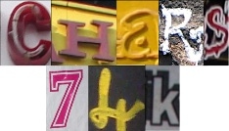
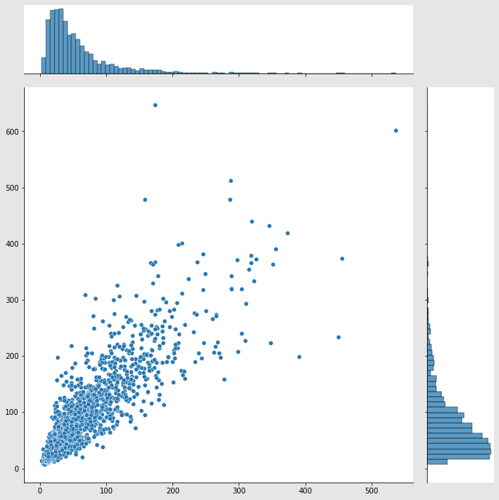
Dataset
The Chars74K Dataset – Character Recognition in Natural Images
http://www.ee.surrey.ac.uk/CVSSP/demos/chars74k/index.html
Datasets converted from MATLAB format to CSV format
62 Labels: 0-9, A-Z, a-z
Total of 2,704 images used (pre-split) …
Training Set: 930 – 15 images for each label
Validation Set: 844 – 15 images for 50 labels & between 2-13 images for rest
Test Set: 930 – 15 images for each label
Image sizes (width × height) …
Minimum: 3 × 7, Maximum: 536 × 647, Average: ~57 × ~82, Median: 41 × 63

Slide 5
Approach – Tools
AzureML Notebook
Python
Numpy
Pandas
Seaborn
Matplotlib
Cv2
Scikit-Learn
Tensorflow
Microsoft Excel
Power BI

Slide 6
Approach – Techniques
Images …
converted to grayscale
resized to 128 × 128
rescaled to be between 0 and 1
Convolutional Neural Network (CNN)
Conv2D layers of 32, 64, 128, 256 with kernel size: 3 × 3, activation: rectified linear unit (RELU)
MaxPooling2D of 2 × 2 after each Conv2D layer
Flattening layer, Dense layer of 512 (RELU)
Dropout layer of 50%
Final Dense layer of 62 with activation: Softmax
Training Set augmented …
random rotations: up to ±15°
width/height shifted: up to ±10%
shear range: up to 10% CCW
zoom: ±10%
fill mode: nearest
Training on up to 1000 epochs …
Using Training and Validation Sets
Batch size: 32
Loss function: categorical cross entropy
Optimizer: adam
Early Stopping on validation loss with patience: 25
Evaluation with Test Set

Slide 7

Outcome – Metrics
Definitions
Loss: metric of discrepancy between expected and predicted results using a loss function (e.g. MSE)
Accuracy (A): probability that a correct (positive or negative) prediction occurred out of all possible results
Precision (P): probability that a correct positive prediction occurred out of all positive predicted results
Recall (R): probability that a correct positive prediction occurred out of all positive expected results
F1 Score: $\frac{1}{F_{1}}=\frac{1}{P}+\frac{1}{R}$
Validation:
Loss: 1.75, Accuracy: 0.68, Support: 844 images
Test:
Loss: 1.88, Accuracy: 0.60, Support: 930 images
(Macro Average) Precision: 0.63, Recall: 0.60, F1: 0.60
(Weighted Macro Average) Precision: 0.63, Recall: 0.60, F1: 0.60

Slide 8
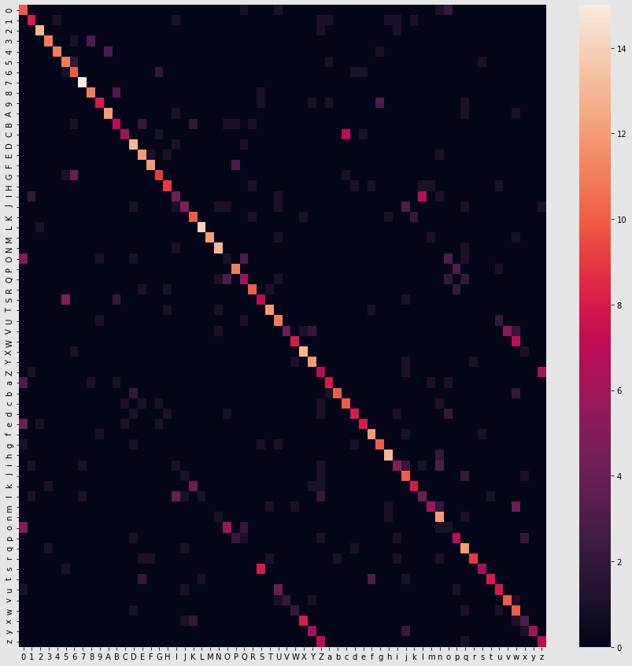
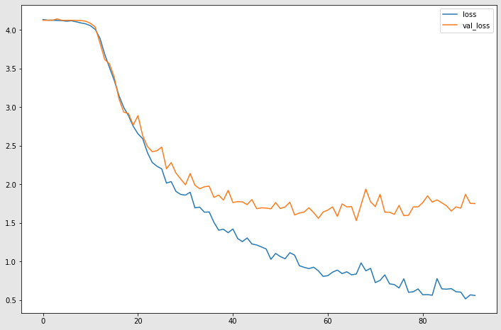
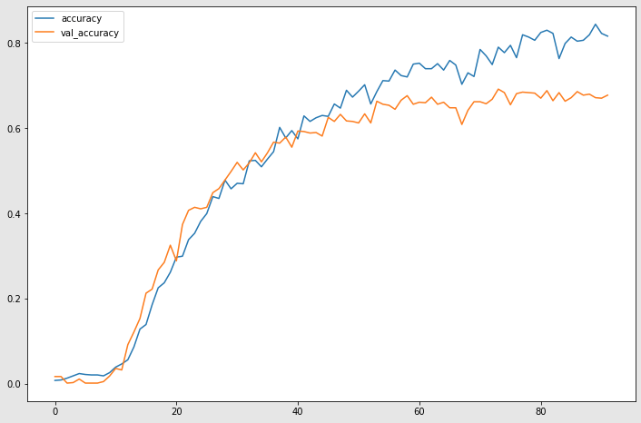
Outcome – Charts

Slide 9
Outcome – Demo …

Slide 10
Challenges
Most time spent …
researching model design
training the model
Significant time spent …
Trying to connect Power BI to Azure
Implementing workarounds
Changed data sets …
Original handwritten text dataset from Kaggle – too many images and too many labels!
Unfamiliar with CV ML techniques to solve
Databricks
Community version had storage limitation
Divergence version wasn’t ready
Unfamiliar with MLFlow
Hard to add Tensorflow to it

Slide 11
Future Work
Practical
Applications of work extended to related problems
Technical
Accessing and learning the tools to get the job done

Slide 12
Future Work – Practical
Better design of ML network to increase accuracy and other metrics
Extend the work to include words on entire signs
Extend the work to include handwritten text or cursive
After conversion to text, use Natural Language Processing (NLP) …
Language translation
Identify authorship on historical handwritten documents
Use signage to augment self-driving vehicle capabilities

Slide 13
Future Work – Technical
Find a way to create a proper Image Dataset in Azure
Learn the AzureML or Databricks MLFlow tools to build a model
Use the Designer to create a visual AzureML Pipeline
Make a proper endpoint to Azure to run Machine Learning models remotely
Determine how to display image thumbnails in Power BI
Integrate Python with Power BI to plot results from pipeline

Slide 14
Questions?

